Slide 1
Dynamic Programming

Slide 2
Dynamic Programming
Another strategy for designing algorithms is dynamic programming
A technique, not an algorithm (like divide & conquer)
The word “programming” is historical and predates computer programming
Use when problem breaks down into recurring small subproblems

Slide 3
Dynamic Programming
Dynamic Programming is a general algorithm design technique for solving problems defined by recurrences with overlapping subproblems
Invented by American mathematician Richard Bellman in the 1950s to solve optimization problems and later assimilated by CS
“Programming” here means “planning”
Main idea:
set up a recurrence relating a solution to a larger instance to solutions of some smaller instances
solve smaller instances once
record solutions in a table
extract solution to the initial instance from that table

Slide 4
What is dynamic programming
This sounds similar to divide-and-conquer
However, they are different:
In divide-and-conquer, the subproblems don’t overlap
In dynamic programming, the subproblems overlap
Subproblems share sub-subproblems!
Divide-&-conquer works best when all subproblems are independent. So, pick partition that makes algorithm most efficient & simply combine solutions to solve entire problem.
Dynamic programming is needed when subproblems are dependent we don’t know where to partition the problem.

Slide 5
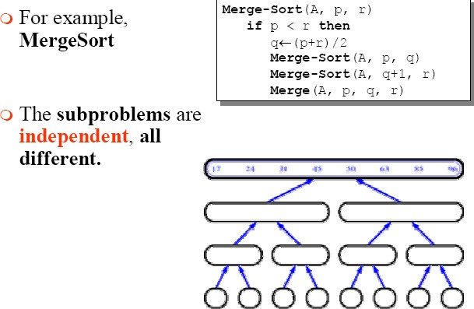
Divide-and-conquer - Example

Slide 6
Dynamic programming
Dynamic programming is a way of improving on inefficient recursive algorithms.
By “inefficient”, we mean that the same recursive call is made over and over.
If same subproblem is solved several times, we can use table to store result of a subproblem the first time it is computed and thus never have to recompute it again.
Dynamic programming is applicable when the subproblems are
dependent, that is, when subproblems share subsubproblems.

Slide 7
Dynamic programming is typically applied to optimization problems. In such problem there can be many solutions. Each solution has a value, and we wish to find a solution with the optimal value.

Slide 8
Dynamic programming
It is used, when the solution can be recursively described in terms of solutions to subproblems (optimal substructure)
Algorithm finds solutions to subproblems and stores them in memory for later use (overlapping subproblems)
More efficient than “brute-force methods”, which solve the same subproblems over and over again

Slide 9
Computing Fibonacci Numbers
Fibonacci numbers:
F₀ = 0
F₁ = 1
F_{n} = F_{n - 1} + F_{n - 2} for n > 1
Sequence is 0, 1, 1, 2, 3, 5, 8, 13, …
Obvious recursive algorithm:
Fib(n):
if n = 0 or 1 then
return n
else
return ( Fib(n − 1) + Fib(n − 2) )
Notes:
9

Slide 10
Recursion Tree for Fib(5)
Fib(5)
Fib(4)
Fib(3)
Fib(3)
Fib(2)
Fib(2)
Fib(1)
Fib(2)
Fib(1)
Fib(1)
Fib(0)
Fib(1)
Fib(0)
Fib(1)
Fib(0)
Notes:
10

Slide 11
How Many Recursive Calls?
If all leaves had the same depth, then there would be about 2^{n} recursive calls.
But this is over-counting.
exponential!
Wasteful approach - repeat work unnecessarily
Fib(2) is computed three times
Instead, compute Fib(2) once, store result in a table, and access it when needed
Notes:
11

Slide 12
Get Rid of the Recursion
Recursion adds overhead
extra time for function calls
extra space to store information on the runtime stack about each currently active function call
Avoid the recursion overhead by filling in the table entries bottom up, instead of top down.
Notes:
12

Slide 13
Subproblem Dependencies
F₀ F₁ F₂ F₃ … F_{n-2} F_{n-1} F_{n}
Figure out which subproblems rely on which other subproblems
Example:
Notes:
13

Slide 14
Order for Computing Subproblems
called Dynamic Programming
Then figure out an order for computing the subproblems that respects the dependencies:
when you are solving a subproblem, you have already solved all the subproblems on which it depends
Example: Just solve them in the order
F₀ , F₁ , F₂ , F₃ , …
Notes:
14

Slide 15
DP Solution for Fibonacci
Fib(n):
F[0] := 0; F[1] := 1;
for i := 2 to n do
F[i] := F[i − 1] + F[i − 2]
return F[n]
Can perform application-specific optimizations
e.g., save space by only keeping last two numbers computed
time reduced from
exponential to linear!
Notes:
15

Slide 16
Principle of Optimality
The dynamic Programming works on a principle of optimality.
Principle of optimality states that in an optimal sequence of decisions or choices, each sub sequences must also be optimal.

Slide 17
Longest Common Subsequence (LCS)
Application: comparison of two strings
Ex: X= {A B C B D A B }, Y= {B D C A B A}
Longest Common Subsequence:
X = A B C B D A B
Y = B D C A B A
Brute force algorithm would compare each subsequence of X with the symbols in Y

Slide 18
LCS Algorithm
First we’ll find the length of LCS. Later we’ll modify the algorithm to find LCS itself.
Define X_{i}, Y_{j} to be the prefixes of X and Y of length i and j respectively
Define c[i,j] to be the length of LCS of X_{i} and Y_{j}
Then the length of LCS of X and Y will be c[m,n]

Slide 19
LCS recursive solution
We start with i = j = 0 (empty substrings of x and y)
Since X₀ and Y₀ are empty strings, their LCS is always empty (i.e. c[0,0] = 0)
LCS of empty string and any other string is empty, so for every i and j: c[0, j] = c[i,0] = 0

Slide 20
LCS recursive solution
When we calculate c[i,j], we consider two cases:
First case: x[i]=y[j]: one more symbol in strings X and Y matches, so the length of LCS X_{i} and Y_{j} equals to the length of LCS of smaller strings X_{i-1} and Y_{i-1} , plus 1

Slide 21
LCS recursive solution
Second case: x[i] != y[j]
As symbols don’t match, our solution is not improved, and the length of LCS(X_{i} , Y_{j}) is the same as before (i.e. maximum of LCS(X_{i}, Y_{j-1}) and LCS(X_{i-1},Y_{j})

Slide 22
LCS Length Algorithm
LCS-Length(X, Y)
1. m = length(X) // get the # of symbols in X
2. n = length(Y) // get the # of symbols in Y
3. for i = 1 to m c[i,0] = 0 // special case: Y₀
4. for j = 1 to n c[0,j] = 0 // special case: X₀
5. for i = 1 to m // for all X_{i}
6. for j = 1 to n // for all Y_{j}
7. if ( X_{i} == Y_{j} )
8. c[i,j] = c[i-1,j-1] + 1
9. else c[i,j] = max( c[i-1,j], c[i,j-1] )
10. return c

Slide 23
LCS Example
We’ll see how LCS algorithm works on the following example:
X = ABCB
Y = BDCAB
What is the Longest Common Subsequence
of X and Y?
LCS(X, Y) = BCB
X = A B C B
Y = B D C A B

Slide 24
LCS Example (0)
ABCB
BDCAB
j 0 1 2 3 4 5
i
Yj
B
D
C
A
B
0
Xi
A
1
2
B
3
C
4
B
X = ABCB; m = |X| = 4
Y = BDCAB; n = |Y| = 5
Allocate array c[5,4]

Slide 25
LCS Example (1)
ABCB
BDCAB
j 0 1 2 3 4 5
i
Yj
B
D
C
A
B
0
Xi
0
0
0
0
0
0
A
1
0
2
B
0
3
C
0
4
B
0
for i = 1 to m c[i,0] = 0
for j = 1 to n c[0,j] = 0

Slide 26
LCS Example (2)
ABCB
BDCAB
j 0 1 2 3 4 5
i
Yj
B
D
C
A
B
0
Xi
0
0
0
0
0
0
A
1
0
0
2
B
0
3
C
0
4
B
0
if ( X_{i} == Y_{j} )
c[i,j] = c[i-1,j-1] + 1
else c[i,j] = max( c[i-1,j], c[i,j-1] )

Slide 27
LCS Example (3)
ABCB
BDCAB
j 0 1 2 3 4 5
i
Yj
B
D
C
A
B
0
Xi
0
0
0
0
0
0
A
1
0
0
0
0
2
B
0
3
C
0
4
B
0
if ( X_{i} == Y_{j} )
c[i,j] = c[i-1,j-1] + 1
else c[i,j] = max( c[i-1,j], c[i,j-1] )

Slide 28
LCS Example (4)
ABCB
BDCAB
j 0 1 2 3 4 5
i
Yj
B
D
C
A
B
0
Xi
0
0
0
0
0
0
A
1
0
0
0
0
1
2
B
0
3
C
0
4
B
0
if ( X_{i} == Y_{j} )
c[i,j] = c[i-1,j-1] + 1
else c[i,j] = max( c[i-1,j], c[i,j-1] )

Slide 29
LCS Example (5)
ABCB
BDCAB
j 0 1 2 3 4 5
i
Yj
B
D
C
A
B
0
Xi
0
0
0
0
0
0
A
1
0
0
0
0
1
1
2
B
0
3
C
0
4
B
0
if ( X_{i} == Y_{j} )
c[i,j] = c[i-1,j-1] + 1
else c[i,j] = max( c[i-1,j], c[i,j-1] )

Slide 30
LCS Example (6)
ABCB
BDCAB
j 0 1 2 3 4 5
i
Yj
B
D
C
A
B
0
Xi
0
0
0
0
0
0
A
1
0
0
0
0
1
1
2
B
0
1
3
C
0
4
B
0
if ( X_{i} == Y_{j} )
c[i,j] = c[i-1,j-1] + 1
else c[i,j] = max( c[i-1,j], c[i,j-1] )

Slide 31
LCS Example (7)
ABCB
BDCAB
j 0 1 2 3 4 5
i
Yj
B
D
C
A
B
0
Xi
0
0
0
0
0
0
A
1
0
0
0
0
1
1
2
B
0
1
1
1
1
3
C
0
4
B
0
if ( X_{i} == Y_{j} )
c[i,j] = c[i-1,j-1] + 1
else c[i,j] = max( c[i-1,j], c[i,j-1] )

Slide 32
LCS Example (8)
ABCB
BDCAB
j 0 1 2 3 4 5
i
Yj
B
D
C
A
B
0
Xi
0
0
0
0
0
0
A
1
0
0
0
0
1
1
2
B
0
1
1
1
1
2
3
C
0
4
B
0
if ( X_{i} == Y_{j} )
c[i,j] = c[i-1,j-1] + 1
else c[i,j] = max( c[i-1,j], c[i,j-1] )

Slide 33
LCS Example (10)
ABCB
BDCAB
j 0 1 2 3 4 5
i
Yj
B
D
C
A
B
0
Xi
0
0
0
0
0
0
A
1
0
0
0
0
1
1
2
B
0
1
1
1
1
2
3
C
0
1
1
4
B
0
if ( X_{i} == Y_{j} )
c[i,j] = c[i-1,j-1] + 1
else c[i,j] = max( c[i-1,j], c[i,j-1] )

Slide 34
LCS Example (11)
ABCB
BDCAB
j 0 1 2 3 4 5
i
Yj
B
D
C
A
B
0
Xi
0
0
0
0
0
0
A
1
0
0
0
0
1
1
2
B
0
1
1
1
1
2
3
C
0
1
1
2
4
B
0
if ( X_{i} == Y_{j} )
c[i,j] = c[i-1,j-1] + 1
else c[i,j] = max( c[i-1,j], c[i,j-1] )

Slide 35
LCS Example (12)
ABCB
BDCAB
j 0 1 2 3 4 5
i
Yj
B
D
C
A
B
0
Xi
0
0
0
0
0
0
A
1
0
0
0
0
1
1
2
B
0
1
1
1
1
2
3
C
0
1
1
2
2
2
4
B
0
if ( X_{i} == Y_{j} )
c[i,j] = c[i-1,j-1] + 1
else c[i,j] = max( c[i-1,j], c[i,j-1] )

Slide 36
LCS Example (13)
ABCB
BDCAB
j 0 1 2 3 4 5
i
Yj
B
D
C
A
B
0
Xi
0
0
0
0
0
0
A
1
0
0
0
0
1
1
2
B
0
1
1
1
1
2
3
C
0
1
1
2
2
2
4
B
0
1
if ( X_{i} == Y_{j} )
c[i,j] = c[i-1,j-1] + 1
else c[i,j] = max( c[i-1,j], c[i,j-1] )

Slide 37
LCS Example (14)
ABCB
BDCAB
j 0 1 2 3 4 5
i
Yj
B
D
C
A
B
0
Xi
0
0
0
0
0
0
A
1
0
0
0
0
1
1
2
B
0
1
1
1
1
2
3
C
0
1
1
2
2
2
4
B
0
1
1
2
2
if ( X_{i} == Y_{j} )
c[i,j] = c[i-1,j-1] + 1
else c[i,j] = max( c[i-1,j], c[i,j-1] )

Slide 38
LCS Example (15)
ABCB
BDCAB
j 0 1 2 3 4 5
i
Yj
B
D
C
A
B
0
Xi
0
0
0
0
0
0
A
1
0
0
0
0
1
1
2
B
0
1
1
1
1
2
3
C
0
1
1
2
2
2
4
B
3
0
1
1
2
2
if ( X_{i} == Y_{j} )
c[i,j] = c[i-1,j-1] + 1
else c[i,j] = max( c[i-1,j], c[i,j-1] )

Slide 39
LCS Algorithm Running Time
LCS algorithm calculates the values of each entry of the array c[m,n]
So what is the running time?
O(m*n)
since each c[i,j] is calculated in constant time, and there are m*n elements in the array

Slide 40
How to find actual LCS
So far, we have just found the length of LCS, but not LCS itself.
We want to modify this algorithm to make it output Longest Common Subsequence of X and Y
Each c[i,j] depends on c[i-1,j] and c[i,j-1]
or c[i-1, j-1]
For each c[i,j] we can say how it was acquired:
For example, here
c[i,j] = c[i-1,j-1] +1 = 2+1=3
2
2
2
3

Slide 41
How to find actual LCS - continued
Remember that
So we can start from c[m,n] and go backwards
Whenever c[i,j] = c[i-1, j-1]+1, remember x[i] (because x[i] is a part of LCS)
When i=0 or j=0 (i.e. we reached the beginning), output remembered letters in reverse order

Slide 42
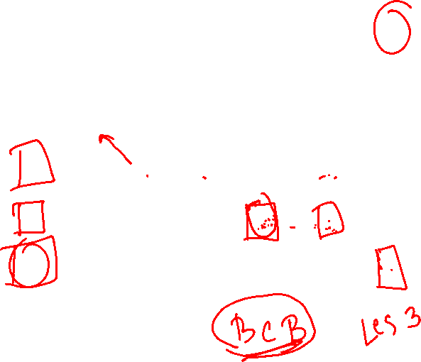
Finding LCS
j 0 1 2 3 4 5
i
Yj
B
D
C
A
B
0
Xi
0
0
0
0
0
0
A
1
0
0
0
0
1
1
2
B
0
1
1
1
2
3
C
0
1
1
2
2
2
4
B
3
0
1
1
2
2

Slide 43
Finding LCS (2)
j 0 1 2 3 4 5
i
Yj
B
D
C
A
B
0
Xi
0
0
0
0
0
0
A
1
0
0
0
0
1
1
2
B
0
1
1
1
1
2
3
C
0
1
1
2
2
2
4
B
3
0
1
1
2
2
LCS (reversed order):
B
C
B
LCS (straight order):
B C B

